Slide 1
FOOD MANAGEMENT SYSTEM
Group-7
Arun B chandran-14
Jyothis S -37
Asa Shijil-75
Deepak P-76

Slide 2
CONTENTS
1. | introduction
2. | problem statement
3. | motivation
4. | Novelty
5. | software requirements
6. | design details
7. | implementation details
8. | intermediate results

Slide 3
Introduction
The Food Management System is a web-based application that helps to manage the food in hostels, catering areas, and hotels. The system provides a platform to display extra food available in the hostel or catering area. Social workers can use this platform to deliver the food without any delivery fee. The system also helps organizations manage their food inventory efficiently and track their food waste, promoting sustainable and responsible food practices.

Slide 4
Problem Statement
In hostels, catering areas, and hotels, a significant amount of food is wasted daily.
The primary reason for this is the difficulty in predicting the amount of food required, leading to excess food preparation and wastage.
This wastage is not only harmful to the environment but also causes financial losses to hostels and catering areas.

Slide 5
Motivation
Food wastage is a major issue that affects not only our finances but also the environment. In many hostels, catering areas, and hotels, extra food is prepared to accommodate guests, leading to large amounts of food going to waste.
By developing a food management system, we can tackle this problem by efficiently managing food inventory, orders, and delivery, ensuring that no food goes to waste.

Slide 6
Novelty
The novelty in this project lies in the integration of various functionalities related to food management such as inventory management, ordering, and delivery by social workers or volunteers. Additionally, the project includes a feature where any extra available food can be displayed.
These functionalities make the project unique and useful for managing food-related operations in a hostel, catering area, or hotel.

Slide 7
Software Requirements
The software requirements for this project are:
Operating System: Windows, Mac OS, or Linux.
Python 3.6 or above.
Django web framework.
HTML, CSS, and JavaScript for front-end development.
MySQL for database management.
Text editor or IDE for coding (e.g. Visual Studio Code, PyCharm).
Git for version control.

Slide 8
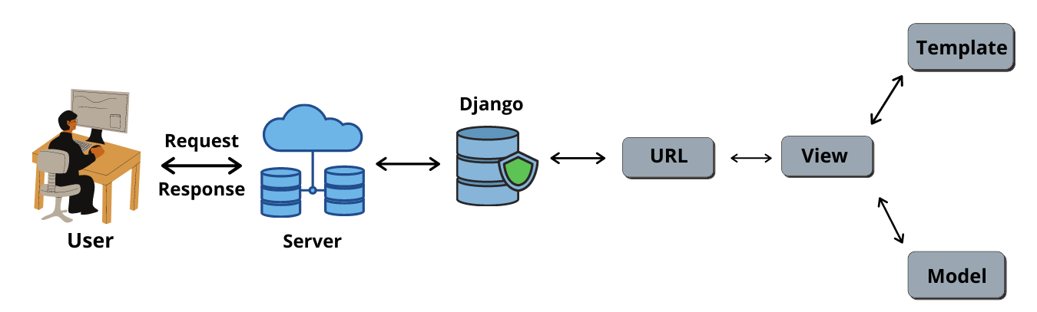
Design Details
Django Architecture:

Slide 9
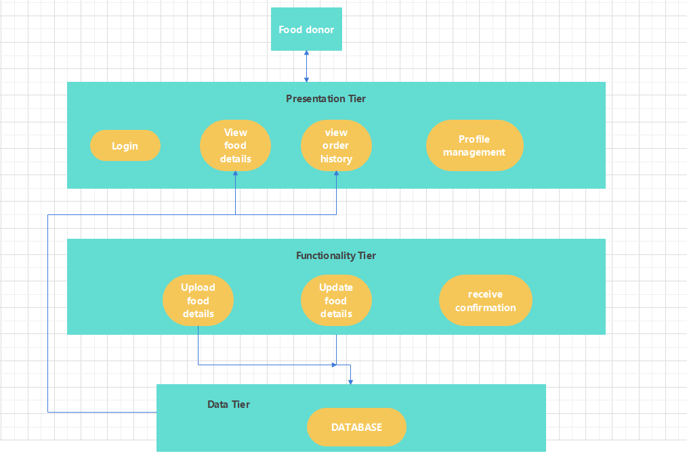
1.Food donors (hotels, hostels, catering):

Slide 10
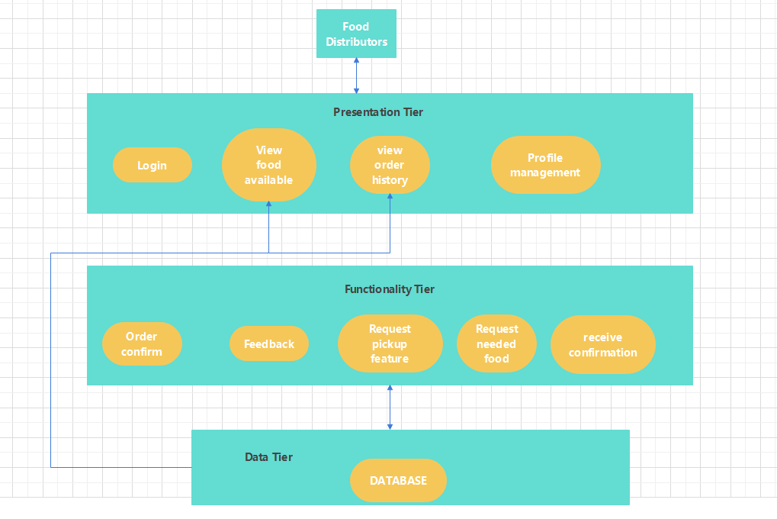
2.Food Distributors (social workers, other social service volunteers ):

Slide 11
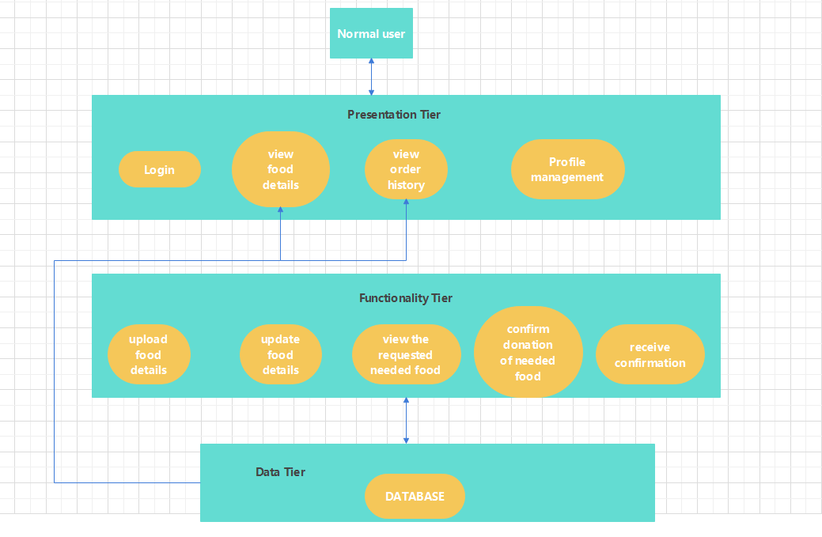
3.Normal Users:

Slide 12
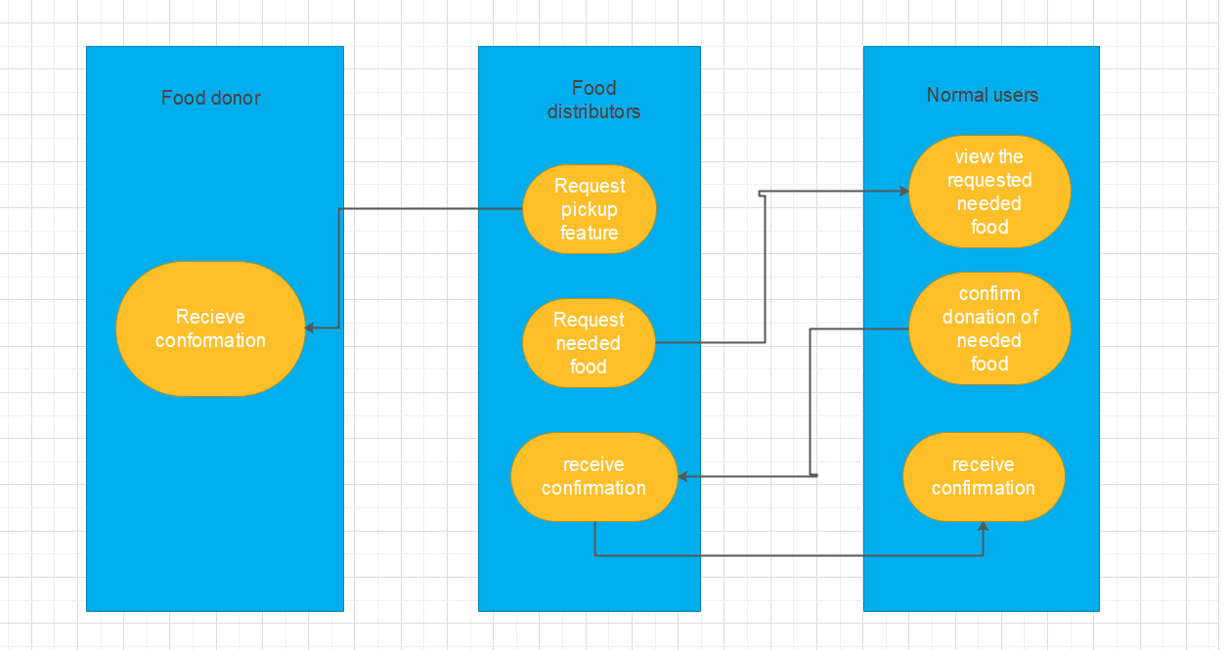
4.User types with their functions:

Slide 13
Implementation Details
1. Front-end Development: The front-end of the Food Management System will be developed using HTML, CSS, and JavaScript.
2. Back-end Development: The back-end of the system will be developed using Django.We will use Django Rest Framework to create APIs that can be used to interact with the database.
3. User Authentication: We will use Django's built-in authentication system to handle user authentication and authorization. Users will be able to sign up, login, and update their profile information.

Slide 14
Implementation Details
4. Food Item Management: Hostel or catering area or hotel staff and normal users will be able to add, update, and delete food items. They can also able to set the quantity of available food items, and the system will automatically update the availability based on the orders placed.
5. Order Management: the food is ordered by the social workers and organization like nss, etc
6. User Profile:- Users will be able to view and edit their profile information like name, address, phone number, etc

Slide 15
Implementation Details
7. Delivery Management: Delivery is done by the social workers Or organization like nss etc
8. Database design:
- User Model: A custom user model will be created to extend Django's default user model. This model will have fields like email, username, password, etc.
- Food Model: This model will have fields like name, description, location, quantity, etc.
- Order Model: This model will have fields like user, food, quantity, status, etc.
- Delivery Model: This model will have fields like order details, delivery type,etc

Slide 16
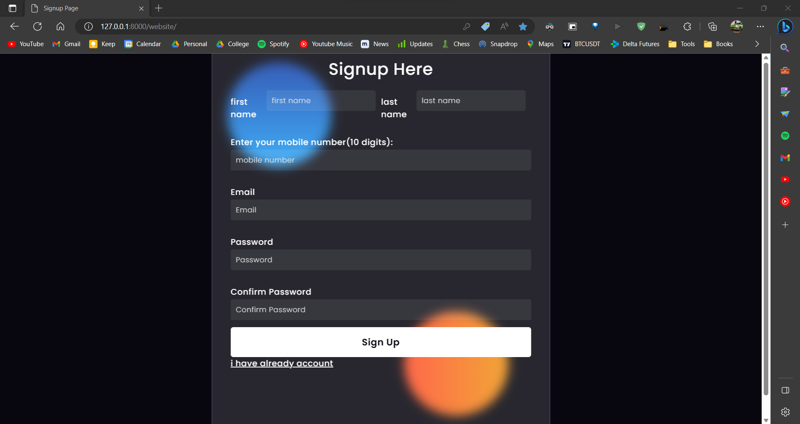
Intermediate results
Studies
Sign up page

Slide 17
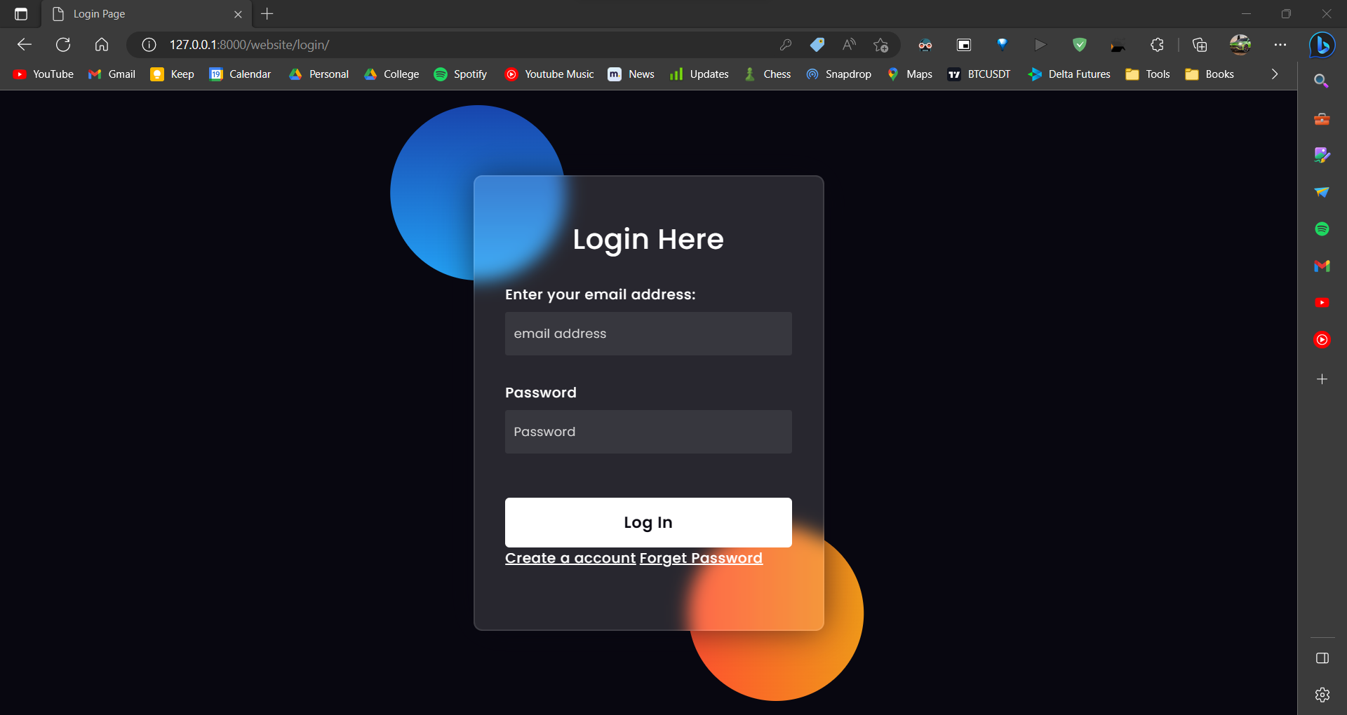
Intermediate results
Studies
Login page

Slide 18
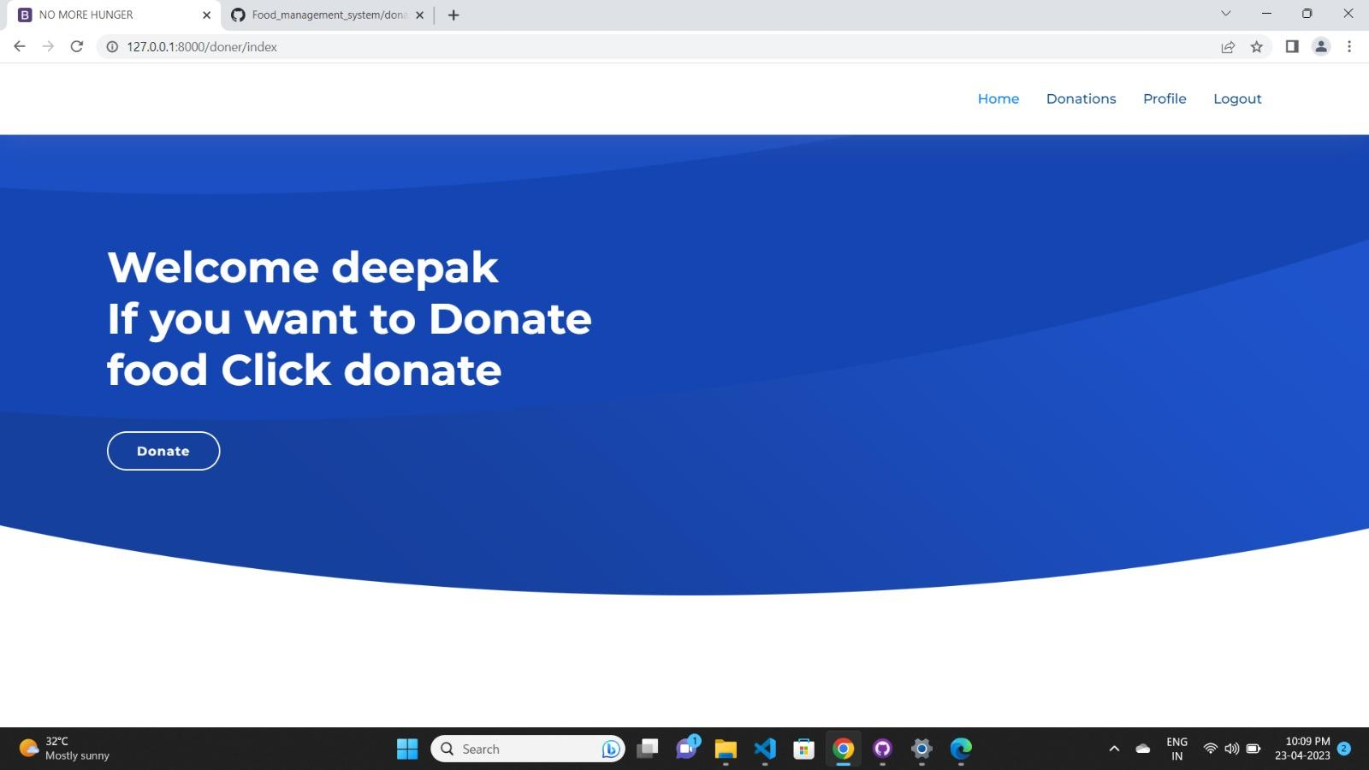
Intermediate results
Studies
Welcome page

Slide 19
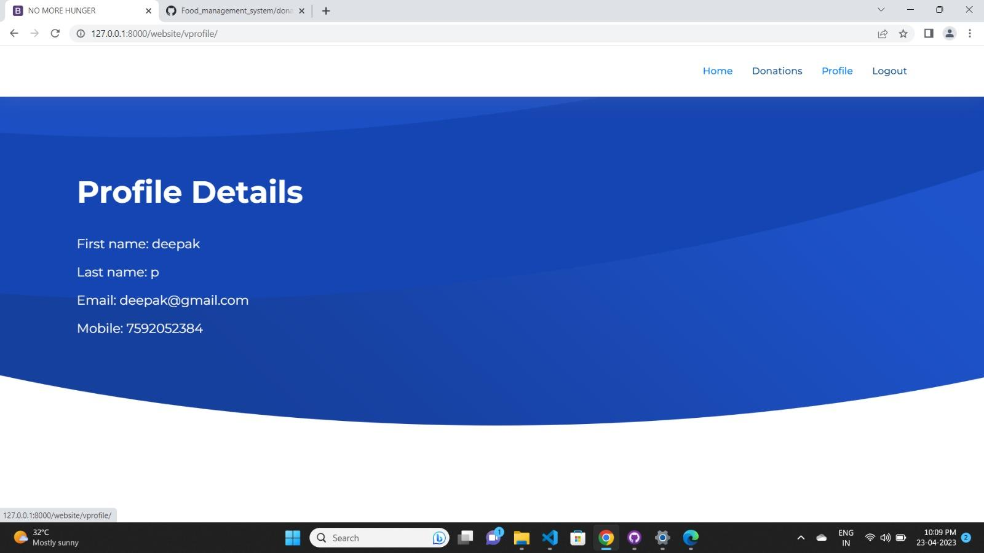
Intermediate results
Studies
Profile details

Slide 20
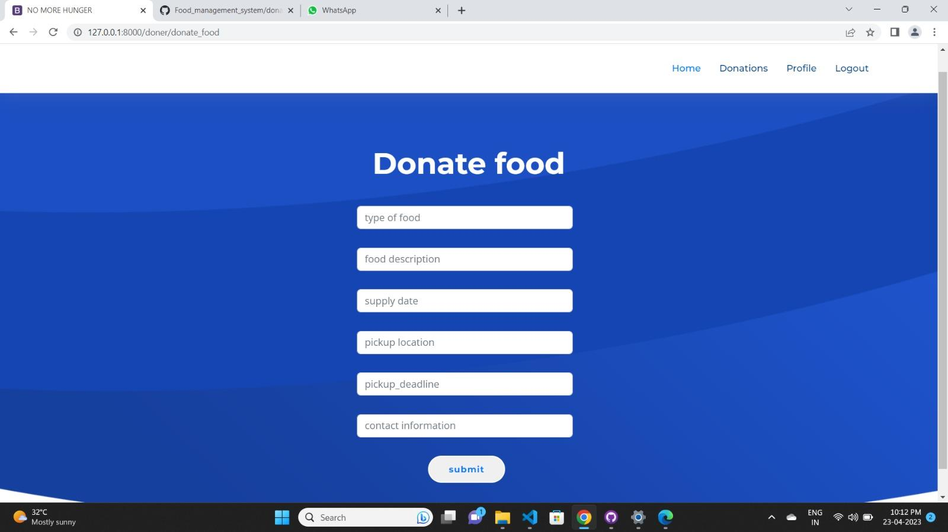
Intermediate results
Studies
Donation page

Slide 21
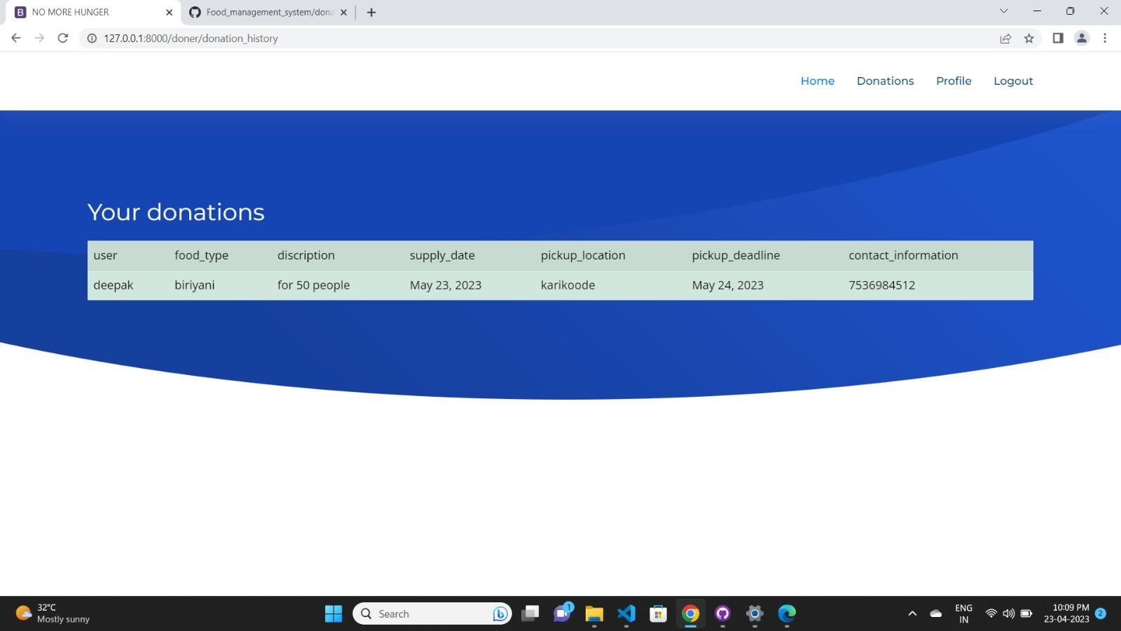
Intermediate results
Studies
Your donations page

Slide 22
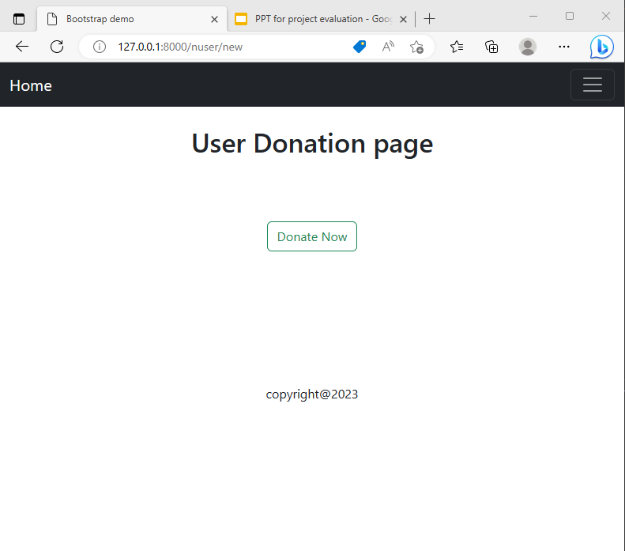
Intermediate results
Studies
User Home page

Slide 23
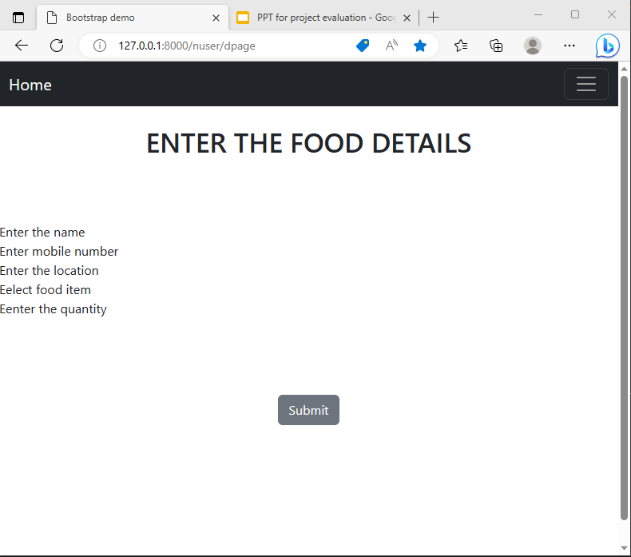
Intermediate results
Studies
User Food donation page

Slide 24
Thank You

